Slide 1
AI and Environment Climate Savior AI?

Slide 2
Climate Savior AI?
Allegation:
Energy and resource consumption in computer science is getting higher and higher
E.g. Crypto Mining (generating virtual money)
50 to 80 terawatt hours (TWh) per year are required That's how much energy all six still active nuclear power plants in Germany generate per year!

Slide 3
Climate Savior AI?
But through the use of AI applications can also positive effects for the environmental and climate protection.

Slide 4

Climate Savior AI? Examples
Thermostat in the Smart Home Learns from the routines of the residents and adapts heating periods to the presences and absences Intelligent linking of weather data, forecast models and the actual heating data

Slide 5

Climate Savior AI? Examples
Lane Keeping Assist when driving
Already energetically profitable if no accident is built by the assistant

Slide 6

Climate Savior AI? Examples
smart traffic control
Measure traffic flow using mobile phone data to avoid traffic jams and send them to affected drivers
Control traffic light controls and speed controls by AI systems to save energy

Slide 7

Climate Savior AI? Examples
The intelligent control system Deepmind from Google
Reduces energy consumption by 40%
Analysis of cooling systems to measure air pressure or temperature

Slide 8
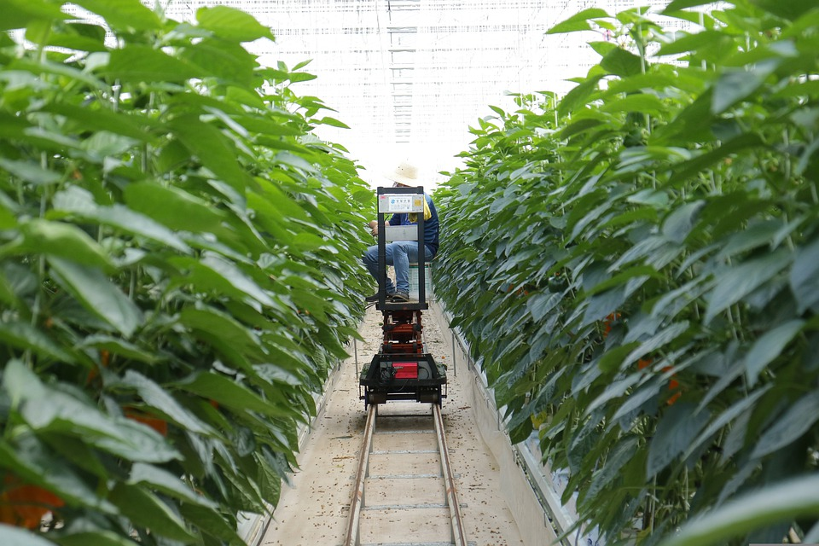
Climate Savior AI? Examples
Smart Farming
Fertilizers and pesticides can be used precisely with the help of AI Efficient field work and harvesting fewer pesticides, more accurate use of agricultural equipment

Slide 9
Practical input Idea lab "Green AI" Development of an intelligent application to save energy

